Slide 1
Embeddings
Notes:
Hello and welcome to the second video of the first day of the course. This video is called Intuitions behind Neural Networws.

Slide 2
Outline
Motivation
Categorical Embedding from Scratch
Examples of Popular Embeddings
Rossmann Cat Embedding
Word2Vec
BERT
Summary

Slide 3
Motivation
Notes:
Hello and welcome to the second video of the first day of the course. This video is called Intuitions behind Neural Networws.

Slide 4
Embeddings
In short, embeddings maps categorical variables into vectors
Notes:
A neural network is nothing more than a "giant function" that seeks to map a set of inputs - we will call X - and outputs - we will call y - from parameters - we will call w -. The fundamental block of the construction of a neural network are the 'perceptrons' - or units - represented by the following figure:

Slide 5
Embeddings
In short, embeddings maps categorical variables into vectors
Categorical
Variable
EB
Vector
Notes:
A neural network is nothing more than a "giant function" that seeks to map a set of inputs - we will call X - and outputs - we will call y - from parameters - we will call w -. The fundamental block of the construction of a neural network are the 'perceptrons' - or units - represented by the following figure:

Slide 6
Embeddings
In short, embeddings maps categorical variables into vectors
Book Title
Lord of the Rings
Harry Potter
Animal Farm
Sherlock Holmes
EB
Vector
Notes:
A neural network is nothing more than a "giant function" that seeks to map a set of inputs - we will call X - and outputs - we will call y - from parameters - we will call w -. The fundamental block of the construction of a neural network are the 'perceptrons' - or units - represented by the following figure:

Slide 7
Embeddings
In short, embeddings maps categorical variables into vectors
Children
Book Title
Lord of the Rings
Harry Potter
Animal Farm
Sherlock Holmes
Harry Potter
EB
Sherlock Holmes
Realism
Fantasy
Lord of the rings
Animal Farm
Adult
Notes:
A neural network is nothing more than a "giant function" that seeks to map a set of inputs - we will call X - and outputs - we will call y - from parameters - we will call w -. The fundamental block of the construction of a neural network are the 'perceptrons' - or units - represented by the following figure:

Slide 8
Embeddings
In short, embeddings maps categorical variables into vectors
Children
Book Title
Lord of the Rings
Harry Potter
Animal Farm
Sherlock Holmes
 | Realism/Fantasy | Children/Adult
Lord of the Rings | 0.9 | -0.3
Harry Potter | 0.9 | 0.7
Animal Farm | -0.4 | -0.8
Sherlock Holmes | -0.8 | 0.2
Harry Potter
Sherlock Holmes
Realism
Fantasy
Lord of the rings
Animal Farm
Adult
Notes:
A neural network is nothing more than a "giant function" that seeks to map a set of inputs - we will call X - and outputs - we will call y - from parameters - we will call w -. The fundamental block of the construction of a neural network are the 'perceptrons' - or units - represented by the following figure:

Slide 9
Embeddings
In short, embeddings maps categorical variables into vectors
Children
Book Title
Lord of the Rings
Harry Potter
Animal Farm
Sherlock Holmes
 | Realism/Fantasy | Children/Adult
Lord of the Rings | 0.9 | -0.3
Harry Potter | 0.9 | 0.7
Animal Farm | -0.4 | -0.8
Sherlock Holmes | -0.8 | 0.2
Harry Potter
Sherlock Holmes
Realism
Fantasy
Lord of the rings
Animal Farm
Adult
But how do we create such table?
Notes:
A neural network is nothing more than a "giant function" that seeks to map a set of inputs - we will call X - and outputs - we will call y - from parameters - we will call w -. The fundamental block of the construction of a neural network are the 'perceptrons' - or units - represented by the following figure:

Slide 10
Embeddings
In short, embeddings maps categorical variables into vectors
Children
Book Title
Lord of the Rings
Harry Potter
Animal Farm
Sherlock Holmes
 | Realism/Fantasy | Children/Adult
Lord of the Rings | 0.9 | -0.3
Harry Potter | 0.9 | 0.7
Animal Farm | -0.4 | -0.8
Sherlock Holmes | -0.8 | 0.2
Harry Potter
Sherlock Holmes
Realism
Fantasy
Lord of the rings
Animal Farm
Adult
We need to set up a classification problem.
Notes:
A neural network is nothing more than a "giant function" that seeks to map a set of inputs - we will call X - and outputs - we will call y - from parameters - we will call w -. The fundamental block of the construction of a neural network are the 'perceptrons' - or units - represented by the following figure:

Slide 11
Embeddings
In short, embeddings maps categorical variables into vectors
Children
Book Title
Lord of the Rings
Harry Potter
Animal Farm
Sherlock Holmes
 | Realism/Fantasy | Children/Adult
Lord of the Rings | 0.9 | -0.3
Harry Potter | 0.9 | 0.7
Animal Farm | -0.4 | -0.8
Sherlock Holmes | -0.8 | 0.2
Harry Potter
Sherlock Holmes
Realism
Fantasy
Lord of the rings
Animal Farm
Adult
We need to set up a classification problem. Always!
Notes:
A neural network is nothing more than a "giant function" that seeks to map a set of inputs - we will call X - and outputs - we will call y - from parameters - we will call w -. The fundamental block of the construction of a neural network are the 'perceptrons' - or units - represented by the following figure:

Slide 12
Embeddings
In short, embeddings maps categorical variables into vectors
Children
Book Title
Lord of the Rings
Harry Potter
Animal Farm
Sherlock Holmes
 | Realism/Fantasy | Children/Adult
Lord of the Rings | 0.9 | -0.3
Harry Potter | 0.9 | 0.7
Animal Farm | -0.4 | -0.8
Sherlock Holmes | -0.8 | 0.2
Harry Potter
Sherlock Holmes
Realism
Fantasy
Lord of the rings
Animal Farm
Adult
Embeddings are created using a supervised env
Notes:
A neural network is nothing more than a "giant function" that seeks to map a set of inputs - we will call X - and outputs - we will call y - from parameters - we will call w -. The fundamental block of the construction of a neural network are the 'perceptrons' - or units - represented by the following figure:

Slide 13
Embeddings
In short, embeddings maps categorical variables into vectors
Children
Book Title
Lord of the Rings
Harry Potter
Animal Farm
Sherlock Holmes
 | Realism/Fantasy | Children/Adult
Lord of the Rings | 0.9 | -0.3
Harry Potter | 0.9 | 0.7
Animal Farm | -0.4 | -0.8
Sherlock Holmes | -0.8 | 0.2
Harry Potter
Sherlock Holmes
Realism
Fantasy
Lord of the rings
Animal Farm
Adult
But can be used for unsupervised problems!
Notes:
A neural network is nothing more than a "giant function" that seeks to map a set of inputs - we will call X - and outputs - we will call y - from parameters - we will call w -. The fundamental block of the construction of a neural network are the 'perceptrons' - or units - represented by the following figure:

Slide 14
Embedding for Categorical Encoding from Scratch
Notes:
Hello and welcome to the second video of the first day of the course. This video is called Intuitions behind Neural Networws.

Slide 15
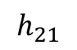
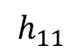
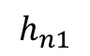
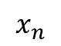
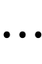
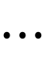
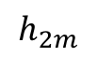
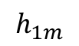
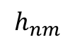
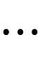
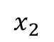
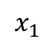
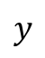
Embeddings
$$h_{11}$$
$$⋯$$
$$h_{1m}$$
$$x_{1}$$
$$x_{2}$$
$$h_{21}$$
$$⋯$$
$$h_{2m}$$
$$y$$
$$⋮$$
$$⋮$$
$$⋮$$
$$x_{n}$$
$$h_{n1}$$
$$⋯$$
$$h_{nm}$$
Notes:
A neural network is nothing more than a "giant function" that seeks to map a set of inputs - we will call X - and outputs - we will call y - from parameters - we will call w -. The fundamental block of the construction of a neural network are the 'perceptrons' - or units - represented by the following figure:

Slide 16
Embeddings
$$h_{11}$$
$$⋯$$
$$h_{1m}$$
 |  |  | Price
 |  |  | 500k
 |  |  | 600k
 |  |  | 900k
 |  |  | 1200k
 |  |  | …
$$x_{1}$$
$$h_{21}$$
$$⋯$$
$$h_{2m}$$
Price
$$x_{2}$$
$$⋮$$
$$⋮$$
$$⋮$$
$$x_{n}$$
$$h_{n1}$$
$$⋯$$
$$h_{nm}$$
Notes:
A neural network is nothing more than a "giant function" that seeks to map a set of inputs - we will call X - and outputs - we will call y - from parameters - we will call w -. The fundamental block of the construction of a neural network are the 'perceptrons' - or units - represented by the following figure:

Slide 17
Embeddings
Area
$$h_{11}$$
$$⋯$$
$$h_{1m}$$
 |  | Area(m2) | Price
 |  | 61 | 500k
 |  | 72 | 600k
 |  | 83 | 900k
 |  | 91 | 1200k
 |  | … | …
$$h_{21}$$
$$⋯$$
$$h_{2m}$$
Price
$$x_{2}$$
$$⋮$$
$$⋮$$
$$⋮$$
$$x_{n}$$
$$h_{n1}$$
$$⋯$$
$$h_{nm}$$
Notes:
A neural network is nothing more than a "giant function" that seeks to map a set of inputs - we will call X - and outputs - we will call y - from parameters - we will call w -. The fundamental block of the construction of a neural network are the 'perceptrons' - or units - represented by the following figure:

Slide 18
Embeddings
Area
$$h_{11}$$
$$⋯$$
$$h_{1m}$$
 | rooms | Area(m2) | Price
 | 4 | 61 | 500k
 | 5 | 72 | 600k
 | 6 | 83 | 900k
 | 7 | 91 | 1200k
 | … | … | …
# of rooms
$$h_{21}$$
$$⋯$$
$$h_{2m}$$
Price
$$⋮$$
$$⋮$$
$$⋮$$
$$x_{n}$$
$$h_{n1}$$
$$⋯$$
$$h_{nm}$$
Notes:
A neural network is nothing more than a "giant function" that seeks to map a set of inputs - we will call X - and outputs - we will call y - from parameters - we will call w -. The fundamental block of the construction of a neural network are the 'perceptrons' - or units - represented by the following figure:

Slide 19
Embeddings
Area
$$h_{11}$$
$$⋯$$
$$h_{1m}$$
Nbhd | rooms | Area(m2) | Price
Tender | 4 | 61 | 500k
Civic | 5 | 72 | 600k
FinDistr | 6 | 83 | 900k
Soma | 7 | 91 | 1200k
… | … | … | …
# of rooms
$$h_{21}$$
$$⋯$$
$$h_{2m}$$
Price
$$⋮$$
$$⋮$$
$$⋮$$
Neighborhood
$$h_{n1}$$
$$⋯$$
$$h_{nm}$$
Notes:
A neural network is nothing more than a "giant function" that seeks to map a set of inputs - we will call X - and outputs - we will call y - from parameters - we will call w -. The fundamental block of the construction of a neural network are the 'perceptrons' - or units - represented by the following figure:

Slide 20
Embeddings
Area
$$h_{11}$$
$$⋯$$
$$h_{1m}$$
Nbhd | rooms | Area(m2) | Price
Tender | 4 | 61 | 500k
Civic | 5 | 72 | 600k
FinDistr | 6 | 83 | 900k
Soma | 7 | 91 | 1200k
… | … | … | …
!
# of rooms
$$⋯$$
Price
$$h_{21}$$
$$h_{2m}$$
$$⋮$$
$$⋮$$
$$⋮$$
Neighborhood
$$h_{n1}$$
$$⋯$$
$$h_{nm}$$
Notes:
A neural network is nothing more than a "giant function" that seeks to map a set of inputs - we will call X - and outputs - we will call y - from parameters - we will call w -. The fundamental block of the construction of a neural network are the 'perceptrons' - or units - represented by the following figure:

Slide 21
Embeddings
Area
$$h_{11}$$
$$⋯$$
$$h_{1m}$$
Nbhd | rooms | Area(m2) | Price
Tender | 4 | 61 | 500k
Civic | 5 | 72 | 600k
FinDistr | 6 | 83 | 900k
Soma | 7 | 91 | 1200k
… | … | … | …
!
# of rooms
$$⋯$$
Price
$$h_{21}$$
$$h_{2m}$$
$$⋮$$
$$⋮$$
$$⋮$$
Neighborhood
$$h_{n1}$$
$$⋯$$
$$h_{nm}$$
Inputs need
to be numeric
Notes:
A neural network is nothing more than a "giant function" that seeks to map a set of inputs - we will call X - and outputs - we will call y - from parameters - we will call w -. The fundamental block of the construction of a neural network are the 'perceptrons' - or units - represented by the following figure:

Slide 22
Embeddings
Area
$$h_{11}$$
$$⋯$$
$$h_{1m}$$
Nbhd | rooms | Area(m2) | Price
0 | 4 | 61 | 500k
1 | 5 | 72 | 600k
2 | 6 | 83 | 900k
3 | 7 | 91 | 1200k
… | … | … | …
# of rooms
$$h_{21}$$
$$⋯$$
$$h_{2m}$$
Price
$$⋮$$
$$⋮$$
$$⋮$$
Neighborhood
$$h_{n1}$$
$$⋯$$
$$h_{nm}$$
Notes:
A neural network is nothing more than a "giant function" that seeks to map a set of inputs - we will call X - and outputs - we will call y - from parameters - we will call w -. The fundamental block of the construction of a neural network are the 'perceptrons' - or units - represented by the following figure:

Slide 23
Embeddings
However, there’s no proximity relationship
Area
$$h_{11}$$
$$⋯$$
$$h_{1m}$$
Nbhd | rooms | Area(m2) | Price
0 | 4 | 61 | 500k
1 | 5 | 72 | 600k
2 | 6 | 83 | 900k
3 | 7 | 91 | 1200k
… | … | … | …
# of rooms
$$h_{21}$$
$$⋯$$
$$h_{2m}$$
Price
$$⋮$$
$$⋮$$
$$⋮$$
Neighborhood
$$h_{n1}$$
$$⋯$$
$$h_{nm}$$
Notes:
A neural network is nothing more than a "giant function" that seeks to map a set of inputs - we will call X - and outputs - we will call y - from parameters - we will call w -. The fundamental block of the construction of a neural network are the 'perceptrons' - or units - represented by the following figure:

Slide 24
Embeddings
Area
$$h_{11}$$
$$⋯$$
$$h_{1m}$$
Nbhd | rooms | Area(m2) | Price
Tender | 4 | 61 | 500k
Civic | 5 | 72 | 600k
FinDistr | 6 | 83 | 900k
Soma | 7 | 91 | 1200k
… | … | … | …
# of rooms
$$h_{21}$$
$$⋯$$
$$h_{2m}$$
Price
$$⋮$$
$$⋮$$
$$⋮$$
Neighborhood
$$h_{n1}$$
$$⋯$$
$$h_{nm}$$
Notes:
A neural network is nothing more than a "giant function" that seeks to map a set of inputs - we will call X - and outputs - we will call y - from parameters - we will call w -. The fundamental block of the construction of a neural network are the 'perceptrons' - or units - represented by the following figure:

Slide 25
Embeddings
Another solution – One-Hot Encoding
Area
$$h_{11}$$
$$⋯$$
$$h_{1m}$$
Nbhd | rooms | Area(m2) | Price
Tender | 4 | 61 | 500k
Civic | 5 | 72 | 600k
FinDistr | 6 | 83 | 900k
Soma | 7 | 91 | 1200k
… | … | … | …
# of rooms
$$h_{21}$$
$$⋯$$
$$h_{2m}$$
Price
$$⋮$$
$$⋮$$
$$⋮$$
Neighborhood
$$h_{n1}$$
$$⋯$$
$$h_{nm}$$
One-Hot Encoding
Tenderl | Civic | FinDistr | Soma
1 | 0 | 0 | 0
0 | 1 | 0 | 0
0 | 0 | 1 | 0
0 | 0 | 0 | 1
Notes:
A neural network is nothing more than a "giant function" that seeks to map a set of inputs - we will call X - and outputs - we will call y - from parameters - we will call w -. The fundamental block of the construction of a neural network are the 'perceptrons' - or units - represented by the following figure:

Slide 26
Embeddings
Another solution – One-Hot Encoding
Area
$$h_{11}$$
$$⋯$$
$$h_{1m}$$
Tenderl | Civic | FinDistr | Soma | rooms | Area) | Price
1 | 0 | 0 | 0 | 4 | 61 | 500k
0 | 1 | 0 | 0 | 5 | 72 | 600k
0 | 0 | 1 | 0 | 6 | 83 | 900k
0 | 0 | 0 | 1 | 7 | 91 | 1200k
… | … | … | … | … | … | …
# of rooms
$$h_{21}$$
$$⋯$$
$$h_{2m}$$
Price
$$⋮$$
$$⋮$$
$$⋮$$
Tenderl
$$h_{n1}$$
$$⋯$$
$$h_{nm}$$
Civic
FinDistr
Soma
Notes:
A neural network is nothing more than a "giant function" that seeks to map a set of inputs - we will call X - and outputs - we will call y - from parameters - we will call w -. The fundamental block of the construction of a neural network are the 'perceptrons' - or units - represented by the following figure:

Slide 27
Embeddings
However, it creates very sparse matrices
Unable to correlate similar categories
Area
$$h_{11}$$
$$⋯$$
$$h_{1m}$$
Tenderl | Civic | FinDistr | Soma | rooms | Area) | Price
1 | 0 | 0 | 0 | 4 | 61 | 500k
0 | 1 | 0 | 0 | 5 | 72 | 600k
0 | 0 | 1 | 0 | 6 | 83 | 900k
0 | 0 | 0 | 1 | 7 | 91 | 1200k
… | … | … | … | … | … | …
# of rooms
$$h_{21}$$
$$⋯$$
$$h_{2m}$$
Price
$$⋮$$
$$⋮$$
$$⋮$$
Tenderl
$$h_{n1}$$
$$⋯$$
$$h_{nm}$$
Civic
FinDistr
Soma
Notes:
The one-hot encoding technique has two main drawbacks:
- For high-cardinality variables — those with many unique categories — the dimensionality of the transformed vector becomes unmanageable.
- The mapping is completely uninformed: “similar” categories are not placed closer to each other in embedding space.

Slide 28
Embeddings
Area
$$h_{11}$$
$$⋯$$
$$h_{1m}$$
Nbhd | rooms | Area(m2) | Price
Tender | 4 | 61 | 500k
Civic | 5 | 72 | 600k
FinDistr | 6 | 83 | 900k
Soma | 7 | 91 | 1200k
… | … | … | …
# of rooms
$$h_{21}$$
$$⋯$$
$$h_{2m}$$
Price
$$⋮$$
$$⋮$$
$$⋮$$
Neighborhood
$$h_{n1}$$
$$⋯$$
$$h_{nm}$$
Notes:
A neural network is nothing more than a "giant function" that seeks to map a set of inputs - we will call X - and outputs - we will call y - from parameters - we will call w -. The fundamental block of the construction of a neural network are the 'perceptrons' - or units - represented by the following figure:

Slide 29
Embeddings
Solution: Embeddings
Area
$$h_{11}$$
$$⋯$$
$$h_{1m}$$
Nbhd | rooms | Area(m2) | Price
Tender | 4 | 61 | 500k
Civic | 5 | 72 | 600k
FinDistr | 6 | 83 | 900k
Soma | 7 | 91 | 1200k
… | … | … | …
# of rooms
$$h_{21}$$
$$⋯$$
$$h_{2m}$$
Price
$$⋮$$
$$⋮$$
$$⋮$$
Neighborhood
$$h_{n1}$$
$$⋯$$
$$h_{nm}$$
Notes:
A neural network is nothing more than a "giant function" that seeks to map a set of inputs - we will call X - and outputs - we will call y - from parameters - we will call w -. The fundamental block of the construction of a neural network are the 'perceptrons' - or units - represented by the following figure:

Slide 30
Embeddings
Solution: Embeddings
First step: replace values by their indexes
Area
$$h_{11}$$
$$⋯$$
$$h_{1m}$$
Nbhd | rooms | Area(m2) | Price
Tender | 4 | 61 | 500k
Civic | 5 | 72 | 600k
FinDistr | 6 | 83 | 900k
Soma | 7 | 91 | 1200k
… | … | … | …
# of rooms
$$h_{21}$$
$$⋯$$
$$h_{2m}$$
Price
$$⋮$$
$$⋮$$
$$⋮$$
Neighborhood
$$h_{n1}$$
$$⋯$$
$$h_{nm}$$
Notes:
A neural network is nothing more than a "giant function" that seeks to map a set of inputs - we will call X - and outputs - we will call y - from parameters - we will call w -. The fundamental block of the construction of a neural network are the 'perceptrons' - or units - represented by the following figure:

Slide 31
Embeddings
Solution: Embeddings
First step: replace values by their indexes
Area
$$h_{11}$$
$$⋯$$
$$h_{1m}$$
Nbhd | rooms | Area(m2) | Price
0 | 4 | 61 | 500k
1 | 5 | 72 | 600k
2 | 6 | 83 | 900k
3 | 7 | 91 | 1200k
… | … | … | …
# of rooms
$$h_{21}$$
$$⋯$$
$$h_{2m}$$
Price
$$⋮$$
$$⋮$$
$$⋮$$
Neighborhood
$$h_{n1}$$
$$⋯$$
$$h_{nm}$$
neibhd_to_idx={0:'Tender',1:'Civic',2:'FDist',3:'Soma'}
Notes:
A neural network is nothing more than a "giant function" that seeks to map a set of inputs - we will call X - and outputs - we will call y - from parameters - we will call w -. The fundamental block of the construction of a neural network are the 'perceptrons' - or units - represented by the following figure:

Slide 32
Embeddings
Solution: Embeddings
Use an embedding layer instead of feeding directly
Area
$$h_{11}$$
$$⋯$$
$$h_{1m}$$
Nbhd | rooms | Area(m2) | Price
0 | 4 | 61 | 500k
1 | 5 | 72 | 600k
2 | 6 | 83 | 900k
3 | 7 | 91 | 1200k
… | … | … | …
# of rooms
$$h_{21}$$
$$⋯$$
$$h_{2m}$$
Price
$$⋮$$
EB
$$⋮$$
$$⋮$$
Neighborhood
$$h_{n1}$$
$$⋯$$
$$h_{nm}$$
neibhd_to_idx={0:'Tender',1:'Civic',2:'FDist',3:'Soma'}
Notes:
A neural network is nothing more than a "giant function" that seeks to map a set of inputs - we will call X - and outputs - we will call y - from parameters - we will call w -. The fundamental block of the construction of a neural network are the 'perceptrons' - or units - represented by the following figure:

Slide 33
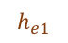
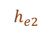
Embeddings
Solution: Embeddings
Let’s take a closer look…
Area
$$h_{11}$$
$$⋯$$
$$h_{1m}$$
Nbhd | rooms | Area(m2) | Price
0 | 4 | 61 | 500k
1 | 5 | 72 | 600k
2 | 6 | 83 | 900k
3 | 7 | 91 | 1200k
… | … | … | …
# of rooms
$$h_{21}$$
$$⋯$$
$$h_{2m}$$
Price
$$⋮$$
EB
$$⋮$$
$$⋮$$
Neighborhood
$$h_{n1}$$
$$⋯$$
$$h_{nm}$$
1
2
$$h_{e1}$$
3
4
$$h_{e2}$$
neibhd_to_idx={0:'Tender',1:'Civic',2:'FDist',3:'Soma'}
Notes:
A neural network is nothing more than a "giant function" that seeks to map a set of inputs - we will call X - and outputs - we will call y - from parameters - we will call w -. The fundamental block of the construction of a neural network are the 'perceptrons' - or units - represented by the following figure:

Slide 34
Embeddings
Solution: Embeddings
At first, they look like a densely connected network
The embedding dimension (# of hidden layers) is chosen manually
Area
$$h_{11}$$
$$⋯$$
$$h_{1m}$$
Nbhd | rooms | Area(m2) | Price
0 | 4 | 61 | 500k
1 | 5 | 72 | 600k
2 | 6 | 83 | 900k
3 | 7 | 91 | 1200k
… | … | … | …
# of rooms
$$h_{21}$$
$$⋯$$
$$h_{2m}$$
Price
$$⋮$$
EB
$$⋮$$
$$⋮$$
Neighborhood
$$h_{n1}$$
$$⋯$$
$$h_{nm}$$
1
2
$$h_{e1}$$
3
4
$$h_{e2}$$
neibhd_to_idx={0:'Tender',1:'Civic',2:'FDist',3:'Soma'}
Notes:
A neural network is nothing more than a "giant function" that seeks to map a set of inputs - we will call X - and outputs - we will call y - from parameters - we will call w -. The fundamental block of the construction of a neural network are the 'perceptrons' - or units - represented by the following figure:

Slide 35
Embeddings
Solution: Embeddings
Categories mapped into vectors using embedding weights
Area
$$h_{11}$$
$$⋯$$
$$h_{1m}$$
Nbhd | rooms | Area(m2) | Price
0 | 4 | 61 | 500k
1 | 5 | 72 | 600k
2 | 6 | 83 | 900k
3 | 7 | 91 | 1200k
… | … | … | …
# of rooms
$$h_{21}$$
$$⋯$$
$$h_{2m}$$
Price
$$⋮$$
EB
$$⋮$$
$$⋮$$
Neighborhood
$$h_{n1}$$
$$⋯$$
$$h_{nm}$$
0
 | h_{e1} | h_{e2}
0 | w1 | w2
1 | w3 | w4
2 | w5 | w6
3 | w7 | w8
1
$$h_{e1}$$
2
3
$$h_{e2}$$
neibhd_to_idx={0:'Tender',1:'Civic',2:'FDist',3:'Soma'}
Notes:
A neural network is nothing more than a "giant function" that seeks to map a set of inputs - we will call X - and outputs - we will call y - from parameters - we will call w -. The fundamental block of the construction of a neural network are the 'perceptrons' - or units - represented by the following figure:

Slide 36
Embeddings
Solution: Embeddings
Weights become analog to a lookup table
Area
$$h_{11}$$
$$⋯$$
$$h_{1m}$$
Nbhd | rooms | Area(m2) | Price
0 | 4 | 61 | 500k
1 | 5 | 72 | 600k
2 | 6 | 83 | 900k
3 | 7 | 91 | 1200k
… | … | … | …
# of rooms
$$h_{21}$$
$$⋯$$
$$h_{2m}$$
Price
$$⋮$$
EB
$$⋮$$
$$⋮$$
Neighborhood
$$h_{n1}$$
$$⋯$$
$$h_{nm}$$
0
 | h_{e1} | h_{e2}
0 | w1 | w2
1 | w3 | w4
2 | w5 | w6
3 | w7 | w8
1
$$h_{e1}$$
2
3
$$h_{e2}$$
neibhd_to_idx={0:'Tender',1:'Civic',2:'FDist',3:'Soma'}
Notes:
A neural network is nothing more than a "giant function" that seeks to map a set of inputs - we will call X - and outputs - we will call y - from parameters - we will call w -. The fundamental block of the construction of a neural network are the 'perceptrons' - or units - represented by the following figure:

Slide 37
Embeddings
Solution: Embeddings
Weights become analog to a lookup table
Area
$$h_{11}$$
$$⋯$$
$$h_{1m}$$
Nbhd | rooms | Area(m2) | Price
0 | 4 | 61 | 500k
1 | 5 | 72 | 600k
2 | 6 | 83 | 900k
3 | 7 | 91 | 1200k
… | … | … | …
# of rooms
$$h_{21}$$
$$⋯$$
$$h_{2m}$$
Price
North
$$⋮$$
EB
$$⋮$$
$$⋮$$
Fin. Distr.
Neighborhood
$$⋯$$
$$h_{n1}$$
$$h_{nm}$$
Tenderl
Soma
Cheaper
Civic
More Expensive
0
 | h_{e1} | h_{e2}
0 | w1 | w2
1 | w3 | w4
2 | w5 | w6
3 | w7 | w8
1
$$h_{e1}$$
South
2
3
$$h_{e2}$$
neibhd_to_idx={0:'Tender',1:'Civic',2:'FDist',3:'Soma'}
Notes:
A neural network is nothing more than a "giant function" that seeks to map a set of inputs - we will call X - and outputs - we will call y - from parameters - we will call w -. The fundamental block of the construction of a neural network are the 'perceptrons' - or units - represented by the following figure:

Slide 38
Examples of Popular Embeddings
Notes:
Hello and welcome to the second video of the first day of the course. This video is called Intuitions behind Neural Networws.

Slide 39
Rossman Store Sales
kaggle.com/c/rossmann-store-sales
Input: 8 columns + engineered ones (ex: Store, State, DayOfWeek, Date, Customers, Open, Promo, StateHoliday, SchoolHoliday)
Output: Sales
Embedding of State
Notes:
A neural network is nothing more than a "giant function" that seeks to map a set of inputs - we will call X - and outputs - we will call y - from parameters - we will call w -. The fundamental block of the construction of a neural network are the 'perceptrons' - or units - represented by the following figure:

Slide 40
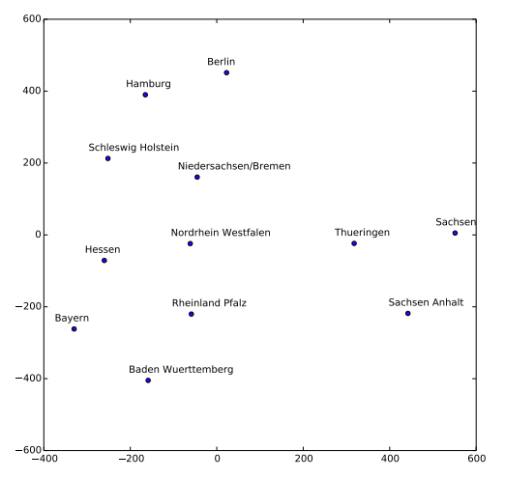
Rossman Store Sales
kaggle.com/c/rossmann-store-sales
Input: 8 columns + engineered ones (ex: Store, State, DayOfWeek, Date, Customers, Open, Promo, StateHoliday, SchoolHoliday)
Output: Sales
Embedding of State (t-SNE projection)
Notes:
A neural network is nothing more than a "giant function" that seeks to map a set of inputs - we will call X - and outputs - we will call y - from parameters - we will call w -. The fundamental block of the construction of a neural network are the 'perceptrons' - or units - represented by the following figure:

Slide 41
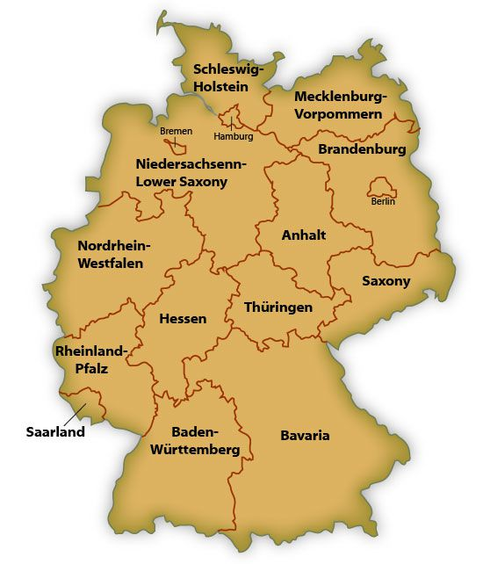
Rossman Store Sales
kaggle.com/c/rossmann-store-sales
Input: 8 columns + engineered ones (ex: Store, State, DayOfWeek, Date, Customers, Open, Promo, StateHoliday, SchoolHoliday)
Output: Sales
Embedding of State
Notes:
A neural network is nothing more than a "giant function" that seeks to map a set of inputs - we will call X - and outputs - we will call y - from parameters - we will call w -. The fundamental block of the construction of a neural network are the 'perceptrons' - or units - represented by the following figure:

Slide 42
Rossman Store Sales
kaggle.com/c/rossmann-store-sales
Input: 8 columns + engineered ones (ex: Store, State, DayOfWeek, Date, Customers, Open, Promo, StateHoliday, SchoolHoliday)
Output: Sales
Embedding of State
Notes:
A neural network is nothing more than a "giant function" that seeks to map a set of inputs - we will call X - and outputs - we will call y - from parameters - we will call w -. The fundamental block of the construction of a neural network are the 'perceptrons' - or units - represented by the following figure:

Slide 43
Rossman Store Sales
kaggle.com/c/rossmann-store-sales
Input: 8 columns + engineered ones (ex: Store, State, DayOfWeek, Date, Customers, Open, Promo, StateHoliday, SchoolHoliday)
Output: Sales
Embedding of State
Notes:
A neural network is nothing more than a "giant function" that seeks to map a set of inputs - we will call X - and outputs - we will call y - from parameters - we will call w -. The fundamental block of the construction of a neural network are the 'perceptrons' - or units - represented by the following figure:

Slide 44
Rossman Store Sales
kaggle.com/c/rossmann-store-sales
Input: 8 columns + engineered ones (ex: Store, State, DayOfWeek, Date, Customers, Open, Promo, StateHoliday, SchoolHoliday)
Output: Sales
Embedding of State: Predicts the map of Germany!
Notes:
A neural network is nothing more than a "giant function" that seeks to map a set of inputs - we will call X - and outputs - we will call y - from parameters - we will call w -. The fundamental block of the construction of a neural network are the 'perceptrons' - or units - represented by the following figure:

Slide 45
Word2Vec
Input: Wikipedia corpus
Dimension: 200
Output (CBoW): The model predicts the current word from a window of surrounding context words
Output (CSG): The model uses the current word to predict the surrounding window of context words
Notes:
Word2vec can utilize either of two model architectures to produce a distributed representation of words: continuous bag-of-words (CBOW) or continuous skip-gram. In the continuous bag-of-words architecture, the model predicts the current word from a window of surrounding context words. The order of context words does not influence prediction (bag-of-words assumption). In the continuous skip-gram architecture, the model uses the current word to predict the surrounding window of context words. The skip-gram architecture weighs nearby context words more heavily than more distant context words.^{[1][5]} According to the authors' note,^{[6]} CBOW is faster while skip-gram is slower but does a better job for infrequent words.

Slide 46
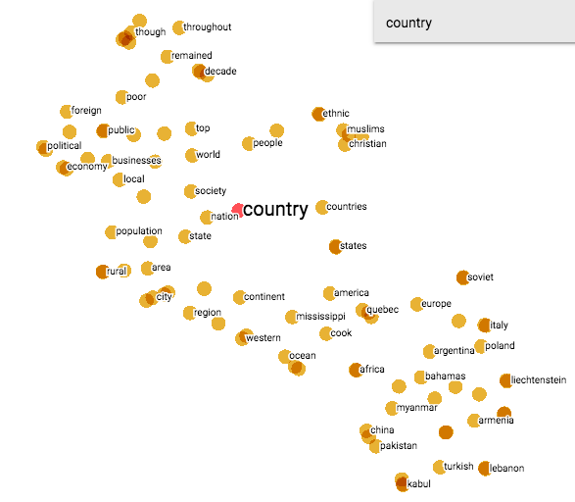
Word2Vec
Input: Wikipedia corpus
Dimension: 200
Output (CBoW): The model predicts the current word from a window of surrounding context words
Output (CSG): The model uses the current word to predict the surrounding window of context words
Examples from: http://projector.tensorflow.org/
Notes:
Word2vec can utilize either of two model architectures to produce a distributed representation of words: continuous bag-of-words (CBOW) or continuous skip-gram. In the continuous bag-of-words architecture, the model predicts the current word from a window of surrounding context words. The order of context words does not influence prediction (bag-of-words assumption). In the continuous skip-gram architecture, the model uses the current word to predict the surrounding window of context words. The skip-gram architecture weighs nearby context words more heavily than more distant context words.^{[1][5]} According to the authors' note,^{[6]} CBOW is faster while skip-gram is slower but does a better job for infrequent words.

Slide 47
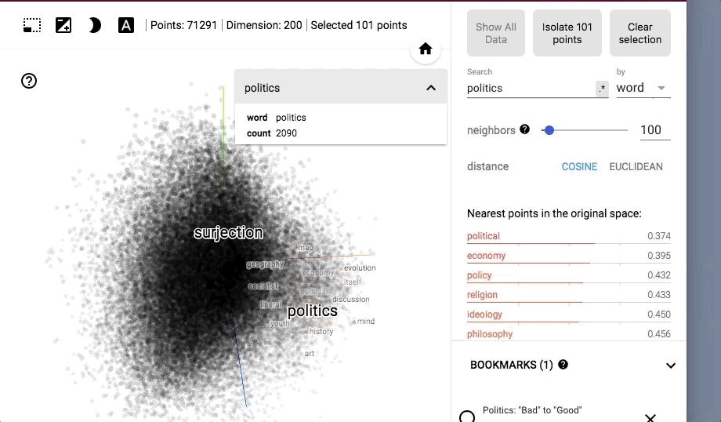
Word2Vec
Input: Wikipedia corpus
Dimension: 200
Output (CBoW): The model predicts the current word from a window of surrounding context words
Output (CSG): The model uses the current word to predict the surrounding window of context words
Examples from: http://projector.tensorflow.org/
Notes:
Word2vec can utilize either of two model architectures to produce a distributed representation of words: continuous bag-of-words (CBOW) or continuous skip-gram. In the continuous bag-of-words architecture, the model predicts the current word from a window of surrounding context words. The order of context words does not influence prediction (bag-of-words assumption). In the continuous skip-gram architecture, the model uses the current word to predict the surrounding window of context words. The skip-gram architecture weighs nearby context words more heavily than more distant context words.^{[1][5]} According to the authors' note,^{[6]} CBOW is faster while skip-gram is slower but does a better job for infrequent words.

Slide 48
BERT
Input: Wikipedia corpus
Output: Masked words
Notes:
Word2vec can utilize either of two model architectures to produce a distributed representation of words: continuous bag-of-words (CBOW) or continuous skip-gram. In the continuous bag-of-words architecture, the model predicts the current word from a window of surrounding context words. The order of context words does not influence prediction (bag-of-words assumption). In the continuous skip-gram architecture, the model uses the current word to predict the surrounding window of context words. The skip-gram architecture weighs nearby context words more heavily than more distant context words.^{[1][5]} According to the authors' note,^{[6]} CBOW is faster while skip-gram is slower but does a better job for infrequent words.

Slide 49
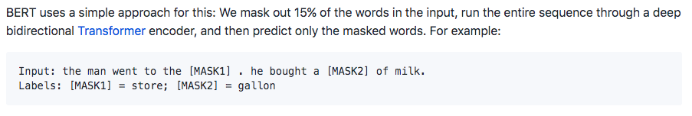
BERT
Input: Wikipedia + BookCorpus
Output: Masked words
Notes:
Word2vec can utilize either of two model architectures to produce a distributed representation of words: continuous bag-of-words (CBOW) or continuous skip-gram. In the continuous bag-of-words architecture, the model predicts the current word from a window of surrounding context words. The order of context words does not influence prediction (bag-of-words assumption). In the continuous skip-gram architecture, the model uses the current word to predict the surrounding window of context words. The skip-gram architecture weighs nearby context words more heavily than more distant context words.^{[1][5]} According to the authors' note,^{[6]} CBOW is faster while skip-gram is slower but does a better job for infrequent words.

Slide 50
Applications
North
Encoding Categorical Variables
Recommendation Systems
Mapping words into vectors
Fin. Distr.
Tenderl
Soma
Cheaper
Civic
More Expensive
South
Children
Harry Potter
Sherlock Holmes
Realism
Fantasy
Lord of the rings
Animal Farm
Adult
Notes:
https://projector.tensorflow.org/

Slide 51
Summary
We use embedding to map categorical variables into a vector
It overcomes the limitations of one-hot encoding
The embedding layer is just a hidden layer
The weights of the embedding serves as a lookup table
Notes:
NN is nothing more than just a bunch of multiplication and sums followed by a non-linear operation such as 1 if positive and 0 if negative. Each block is a perceptron and by combining them in layers, it is proved that they can learn anything!
And finally, in short, deep learning can be defined as just the usage of deep neural networks in order to learn very complex relationships. It will be your job to feed the inputs and outputs of the NN and it will be the job of those NN to learn what are the best weights and biases to correlate both. But how does it learn those wights?? This is what we will see in the next video! We are also are going learn later about the different activation functions and what are their influences for ne neural networks.

Slide 52
Implementing a simplistic example
Next Video
Notes:
Next, we will see how the neural network lean those weghts. See you in the next video.

